Slide 1
Flight Delay Prediction ML System
Team members: Megan Fields · Audrey Hartford · Lila Isett · Jamie Jordan · Melissa Sierocki
BANA 7075
Final Project MVP

Slide 2

Problem & Purpose
Problem: Flight delays affect travelers, airlines, and airports daily, causing angry travelers, frustrated airport employees, and reduced customer satisfaction with specific airlines and airports.
ML Solution: Predict whether a flight will arrive 15+ minutes late
Gives travelers/airlines earlier information about potential delays
Help support better travel and operational decisions
Notes:
Melissa -Clarity of the Problem & ML System Purpose (4 points): Is the problem well-defined, and is the ML system's purpose clearly explained?
Our project is a Flight Delay Prediction System. The goal of our machine learning system is to predict whether a scheduled domestic flight will arrive 15 minutes or more late using information that is available before the flight departs. This matters because earlier delay awareness can help travelers, airlines, and airports make better decisions before disruptions happen.

Slide 3
Flight Delay Prediction – System Diagram
Raw Data
Flight records
Data Preparation
Clean, filter &
engineer features
Processed Dataset
Model-ready
features + target
Train Models
Logistic Regression
Random Forest
MLflow
Track experiments
Model Comparison
Compare model
performance
Select Model
Choose model for
prediction
Predictions
Delay probability
+ class
Parameters
Model settings & feature details
Metrics
Accuracy, Precision, Recall, F1, ROC-AUC
Models
Saved model files & artifacts
Runs
Compare experiments over time
9. Deploy to Streamlit
Interactive web app
Iterate & Improve
Try more data, features, models, and parameters
Notes:
Audrey
Clarity of the ML System Diagram (4 points): Does the system diagram effectively illustrate the data pipeline, model experimentation, and planned deployment?
We focused on three main areas for the MVP: 1. Data Pipeline 2. ML Model Development, especially experiment structure, MLflow planning, model comparison, and versioning 3. Basic System Integration, including our current prediction script and the Streamlit web app

Slide 4
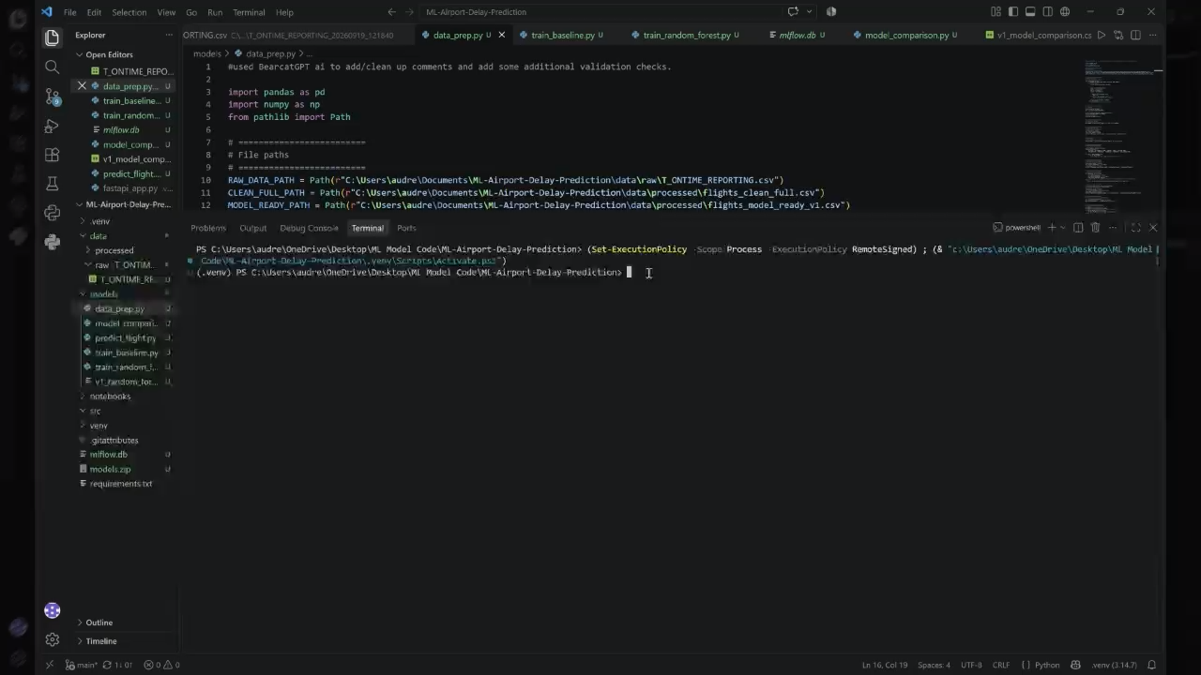
Data Pipeline
Notes:
Audrey
Implementation of Data Pipeline (4 points): Does the prototype include a functional data pipeline with ingestion, processing, validation, and versioning?
Our data pipeline follows the structure we designed in our proposal. We built the MVP as a batch pipeline using historical BTS Airline On-Time Performance data.
Ingestion: The raw BTS file is stored unchanged in the raw data folder. We then use a Python preprocessing script (data_prep.py) to read the raw CSV and prepare it for modeling.
Validation and Cleaning: In the data prep stage, we apply several validation and quality checks – removing cancelled flights, removing diverted flights, drop rows where the target cannot be determined, check values in our important fields, check dataset size before and after filtering, and engineer modeling features only from information available before the flight – not the results after the flight. This information are pre-departure features such as: flight date, route information, origin and destination, schedule departure and arrival times, time features like departure hour, month, day and weekends. This is important because of data leakage. We do not use post-flight information like actual arrival delay as a model input.
We also log the cleaning results in a validation summary and maintain a dataset version log. For version 1, the processed dataset was built from the January 2026 BTS raw file.
Versioning: For reproducibility, we version our processed data files and keep a dataset log. Our current dataset tracking includes dataset version, source file, creation date, row counts before and after cleaning, filters applied and the engineered features. This supports traceability and makes it easier to compare future versions when we add more features like weather or previous-flight information

Slide 5
Model Development & Results – Version 1
Metric | Logistic Regression | Random Forest | Change: RF vs. LR
Accuracy | 71.12% | 58.95% | ↓ 12.17 pts - RF made fewer correct predictions overall
Precision | 34.21% | 27.41% | ↓ 6.80 pts - RF produced more false delay alerts
Recall | 24.31% | 44.89% | ↑ 20.58 pts - RF identified substantially more actual delays
F1 Score | 28.42% | 34.03% | ↑ 5.61 pts - RF had a better precision/recall balance
ROC-AUC | 60.51% | 57.28% | ↓ 3.23 pts - Logistic Regression had better overall ranking ability
Development of version 1:
Goal: Compare baseline/linear approach and Random Forest
Data: January 2026 data: 517,222 flights
  Delayed: 20.8%
  Not delayed: 79.2%
Findings:
  Accuracy was misleading because of class imbalance between delayed and not delayed.
  Recall improved to 59.2% for the initial model and 63.4% for Random Forest
Notes:
Audrey
ML Model Development (4 points): Has an initial model been trained with proper experiment tracking and versioning?
For the MVP, we developed an initial supervised learning pipeline to predict the binary target of 1 = flight delayed by at least.
We trained 2 main Version 1 models...Logistic Regression as the baseline and Random Forest as the primary nonlinear model
We build scripts to load the model-ready dataset, split data chronologically into train, validation, and test periods, preprocess categorical and numeric features, train each model and evaluate performance using our metrics of accuracy, precision, recall, F1 score, ROC-AUC.
The current performance of V1 results show the trade off between the 2 models. Random Forest achieved a stronger recall and F1 score but a lower accuracy and the baseline achieved stronger accuracy, slightly stronger ROC-AUC but a weaker recall. This means that Random Forest is currently better at catching delayed flights, while Logistic Regression is more conservative overall.
For our project goal, recall and F1 are especially important because missing a real delay reduces the usefulness of our system. Based on that, Random Forest is currently our strongest V1 model.
We have also started the structure for experiment tracking. We created an MLFlow and identified what each run should log – model name, dataset version, training script, hyperparameters, validation metrics, test metrics and the saved model artifact path. For the MVP, this gives us a clear path for centralized experiment tracking.
To begin system integration, we built a script (predict_flight.py) that loads the saved trained model, accepts a single flights information from the user, engineering the required input features, predicts the probability that the flight will be delayed, and returns a risk-based output. This means our prototype already supports the core user workflow -> enter a flight, then get back a delay prediction. It returns the predicted probability of delay, the risk level (low, moderate, high) and prediction of delayed or not delayed.
NOTE: other's demo'd MLFlow to show their tracking and versioning

Slide 6
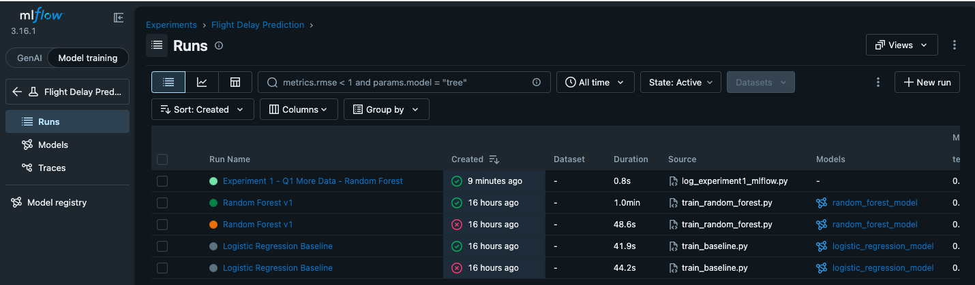
Experiment 1 - Does expanding the training dataset from one month to three (Q1 2026) improve model performance?
Experiment Design
Baseline: January 2026 data
Experiment 1: Q1 2026 dataset - 1,611,874 usable flights
Training: Jan. 1–Feb. 28 - 1,019,618 flights
Validation: Mar. 1–15 - 282,419 flights
Test: Mar. 16–31 — 309,837 flights
Same 11 pre-departure features
Same Random Forest hyperparameters
Results tracked in MLflow
Notes:
Jamie

Slide 7
Experiment 1 - Results
Metric | January Baseline | Q1 Experiment | Change Analysis
Accuracy | 58.95% | 49.71% | ↓ 9.24 pts - More overall predictions were incorrect
Precision | 27.41% | 27.63% | ↑ 0.22 pts - Essentially unchanged
Recall | 44.89% | 74.70% | ↑ 29.81 pts - Major improvement in identifying actual delays
F1 Score | 34.03% | 40.34% | ↑ 6.31 pts - Better balance of precision and recall
ROC-AUC | 57.28% | 62.09% | ↑ 4.81 pts - Improved ability to distinguish delayed vs. non-delayed flights
What we learned:
More historical training data helped the Random Forest capture a much larger share of actual delays, but increased false alarms.
This suggests that additional training data helped identify more true delays but created a tradeoff between recall and false alarms.
The next experiment should focus on improving the precision/recall tradeoff rather than simply adding more data.
Notes:
Jamie

Slide 8
Experiment Roadmap
Stage | Experiment | Primary Question
Initial Development | Baseline Model Comparison | Which model provides the strongest starting point?
Experiment 1 | More Training Data (3 months/ Q1) | Does additional historical data improve delay detection?
Experiment 2 | More Training Data (1 year) | Does additional historical data improve delay detection?
Experiment 3 | Hyperparameter Tuning | Can we improve RF performance through tuning?
Experiment 4 | Classification Threshold | Can we reduce false positives while maintaining strong recall?
Final Model | Model Selection & Validation | Which configuration should be deployed?
Deployment | Streamlit App | Can users enter flight information and receive a delay-risk prediction?
Notes:
Jamie

Slide 9
Prototype Demo
Flight Delay Prediction · Streamlit
Notes:
System Integration (Extra Credit): While not required, early integration into an API, web app, or CLI tool may earn extra credit points.

Slide 10
Challenges & Next Steps
Continue testing with additional flight data
Improve the precision/recall tradeoff and reduce false delay alerts
Continue tracking experiments in MLflow
Test hyperparameter tuning and classification thresholds
Select and version the best-performing model
Continue developing the Streamlit app for travelers
Notes:
Lila -The next step is to connect the training scripts directly into MLFlow so that each model run is automatically recorded and comparable in the MLFlow UI.

Slide 11
Thank you!

